Slide 1
Verifying Correctness of a Chez Scheme compiler pass
Master’s Thesis Presentation by Ian Atol

Slide 2
Outline
Introduction
Background
Definitions
Proof
Validation Frameworks
Conclusion / Future Work

Slide 3
Introduction
Why care about compiler correctness?
Why is proving compiler correctness difficult?
Project overview
Notes:
As you can see by the title, this project is related to compiler correctness.
we should think about why we care about compiler correctness?

Slide 4

Software is all around us - ubiquitous
Notes:
As computer scientists, we already know this, but software is already present nearly everywhere in our lives
We’re on Zoom right now, phones in our pocket, air conditioning, etc

Slide 5
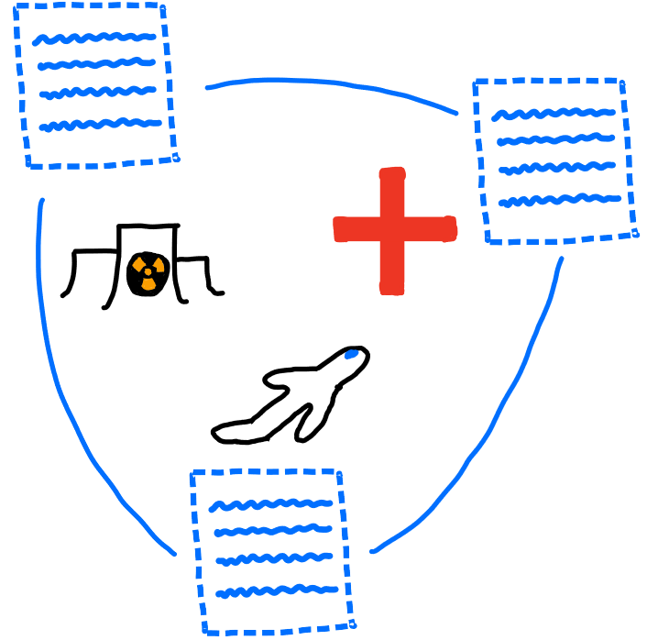
Software ubiquity means software significance
Notes:
Everywhere means everywhere - including in safety critical settings like airplanes, medical equipment, and nuclear reactors.

Slide 6

Software is imperfect
In 2011, 24% of medical device recalls were due to faulty software, and this number is increasing because of increasing complexity of devices
Notes:
We can observe this situation in many areas - complexity is increasing across the board
Needless to say, software errors in equipment thats controlling your heart or at the local nuclear power plant are very bad
So, can we fix?

Slide 7

One approach to errors – Static Analysis
Notes:
In general, static analysis is the process of examining source code.
By carefully analyzing source code, we can devise proofs that certain kinds of errors don’t occur
Some analysis can be performed completely based on the syntax of a program – for ex, every line ending in a semi-colon.
However, for more complex proofs, we give meaning to the source code using the semantics of its language, for ex to prove a program results in a certain value

Slide 8
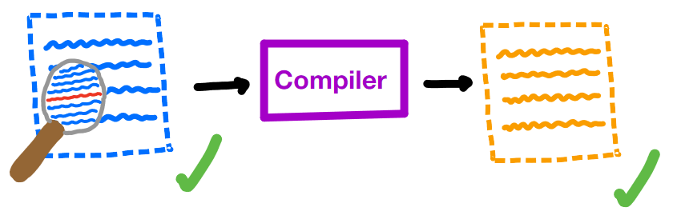
A critical assumption
Notes:
However, these proofs involving the semantics tend to make a critical assumption
We assume that our proof about a program holds for its compiled version - essentially we are trusting that our compiler didn’t make an error
For most cases, this is fine - mainstream compilers are pretty trustworthy, and most use cases aren’t critical
But if you have a pacemaker, for example, this assumption means trusting the compiler with your life

Slide 9

Minimizing assumptions
Notes:
In safety critical software, we want to minimize the assumptions we make.
Therefore, we are no longer assured that our compiled program is error free

Slide 10

Trust, but verify (our compilers)
Notes:
Compilers are really just programs themselves, so we can apply static analysis to them as well
Specifically, we want to prove that our compilers translate correctly - that they preserve the semantics of programs that they compile
If we can prove correctness of our compilers, we can successfully remove an assumption and get closer to full trust of our software

Slide 11
Why aren’t all our compilers proven correct?
Compilers are big
Multiple languages involved
Consider ALL possible programs
Notes:
gcc ~15M lines of code
Compilers typically translate a program in a high level language to a program in a low level language. So we have to create a relationship between the semantics of these languages
Finally, to prove compiler correctness, we have to consider all possible programs in a language. Even for small languages, this can involve concepts that are difficult to reason about like recursion, mutation, etc.

Slide 12
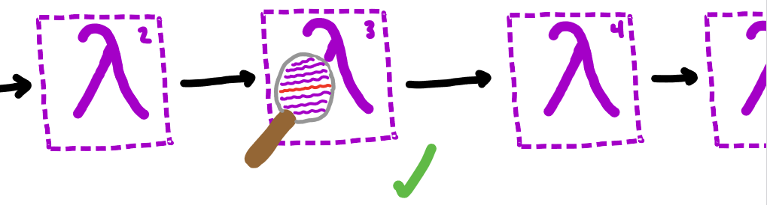
This project
Notes:
In this project, we give a proof of correctness of a single pass of the Chez Scheme compiler over a subset of Scheme
In this way, we simplify each of the problem areas:
Looking at a small part of the compiler
This pass translates from Scheme to Scheme so we can use the same semantics
We also cut out some of the language to reduce complexity

Slide 13

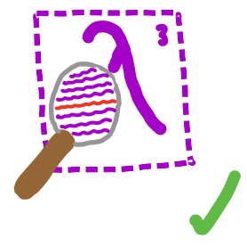

This project
Notes:
We also give two frameworks for validating our proof
The first, in Coq, was originally intended to be a complete mechanization of the proof.
While that ended up being outside of the scope of this work, we still provide an implementation of part of Scheme’s semantics and prove some basic properties about it
The second, in Racket, provides a way to show correctness of the pass (and our proof approach) for individual examples

Slide 14
Background
Compiler Correctness
Scheme

Slide 15
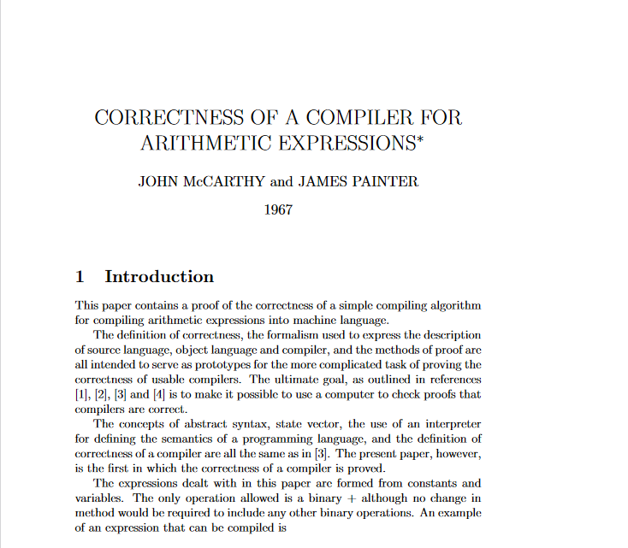
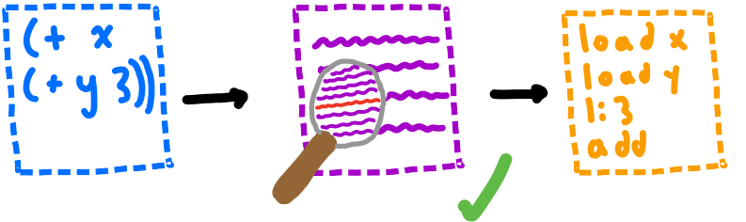
McCarthy, Painter 1967
Notes:
The first proof of compiler correctness comes from John McCarthy and James Painter
They provide a correctness proof for a simple compiler from arithmetic expressions to machine code
Their proof is intentionally simple, as they intended to create a general approach for proving correctness of larger compilers

Slide 16
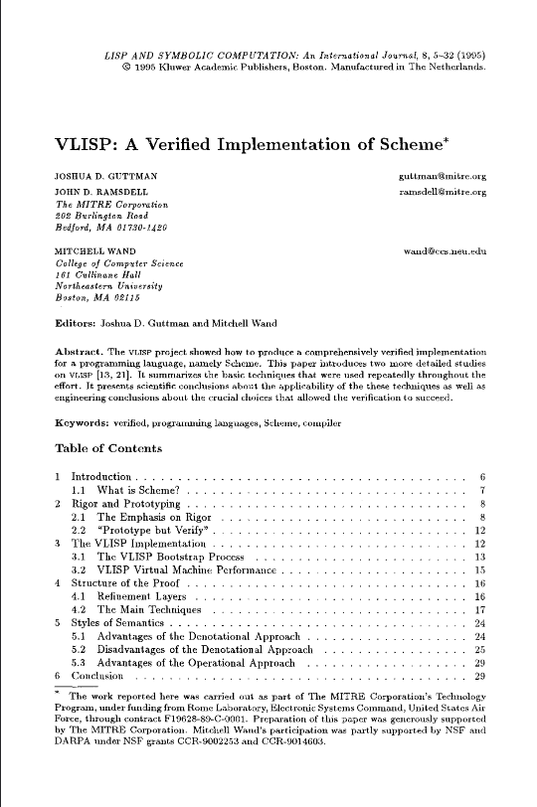

VLISP 1995
Notes:
VLISP is a proof of compiler correctness for an early version of Scheme
Also defines an operational semantics and translates between the operations and denotational semantics
Uses similar techniques to McCarthy’s proof in the operational parts

Slide 17
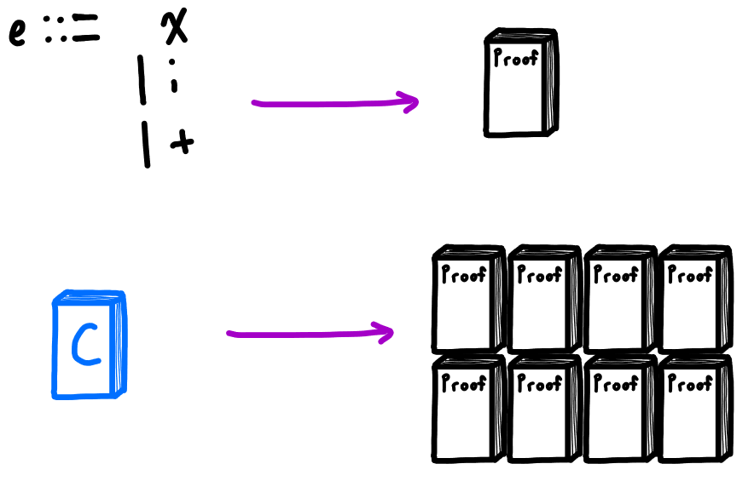
Correctness Proofs are Complex!
Notes:
McCarthy’s proof was about a tiny language of only 3 expressions, but still about 10 pages long
To reason about larger, practical languages, a proof would be very large. Still possible on paper, but checking such a proof by hand is difficult
Solution: use computers to help check

Slide 18

Solution: Mechanization
Notes:
Computers work perfectly and tirelessly – if we could get them to check our proofs, we would have a much higher degree of trust in their validity
For computers to be able to check our proofs, they need to be able to understand them first – we need to encode some system of mathematics

Slide 19
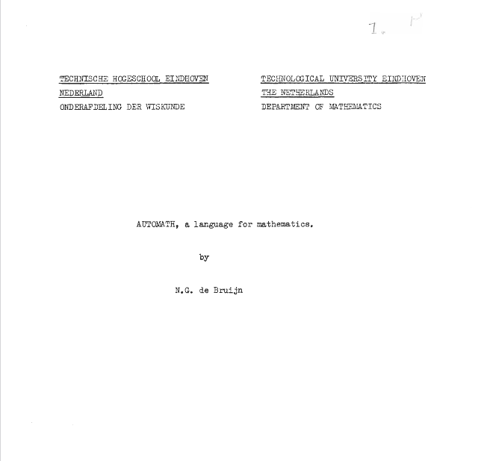
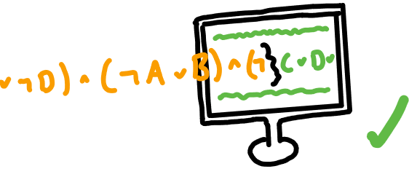
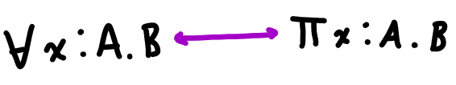
de Bruijn 1968
Notes:
In 1968, de Bruijn released Automath, a system for encoding and checking mathematical theories computationally
Automath does this by exploiting the Curry-Howard correspondence between intuitionistic logic and dependent types
So in Automath, theorems are defined as types, and proofs consist of showing that these types are inhabited by some value
Which means that proofs of theorems are just programs like any other, and their validity can be determined by type checking

Slide 20
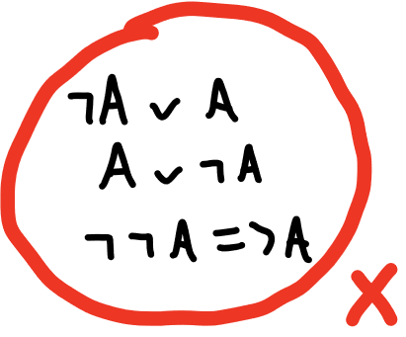

More on Automath and Intuitionistic Logic
Notes:
Automath works by exploiting a correspondence between intuitionistic logic and dependent types
But what is intuitionistic logic? Alternative to classical logic that requires direct proof – no indirect proofs because the law of the excluded middle is not assumed
Constructive because of this requirement of directness – if you want to prove something exists, you must build it directly
For example, a proof that given an integer, a greater integer exists would actually build and give back the greater integer

Slide 21
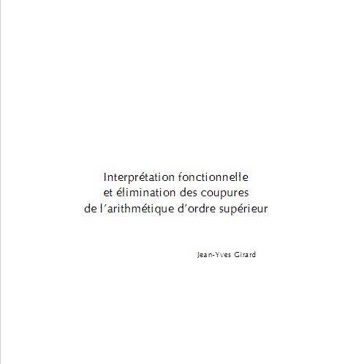
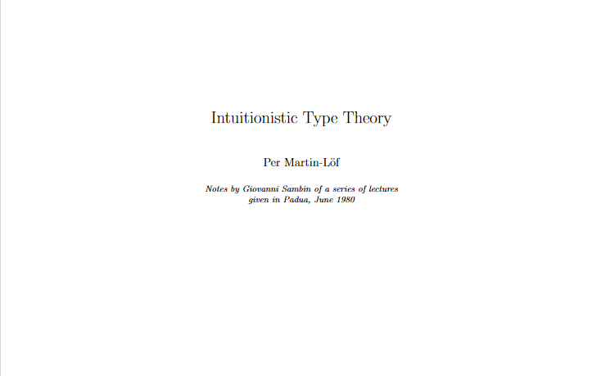
Girard 1972, Martin-Lӧf ~1980
Notes:
Martin-Lof and Girard improved on de Bruijn’s idea of exploiting the Curry Howard correspondence by developing dependent type theories that were more expressive, therefore allowing encoding of more complex math
Girard’s System F is quite similar to the type theory used by Automath, but should be mentioned for being important and famous in its own right
Martin-Lof’s Intuitionistic Type Theory is a full fledged dependent type theory, that was intended to serve as a computational foundation for mathematics

Slide 22
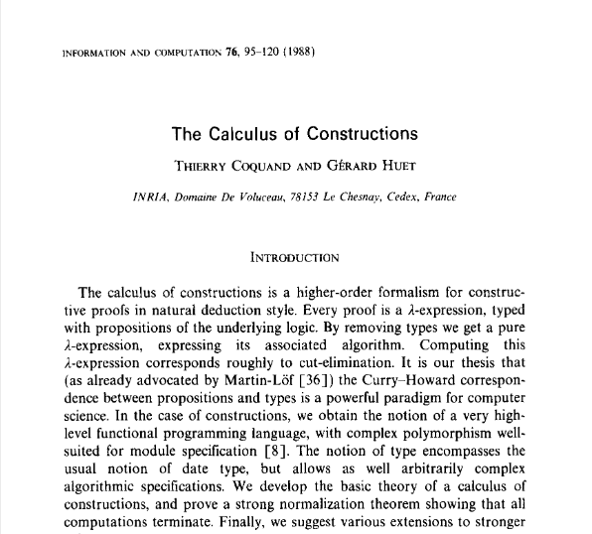
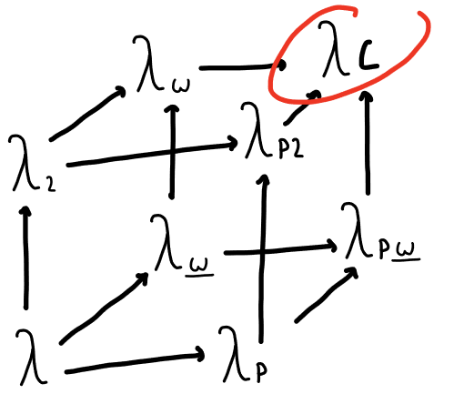
Coquand 1988
Notes:
Coquand developed the Calculus of Constructions, which combined intuitionistic type theory and system F.
Types and terms can depend on types and terms

Slide 23

Coq ~1980s
Notes:
Coq is a system similar to Automath, but provides many features for automation and ease of writing and proving theorems. Its an example of whats called a proof assistant
Because of its specification and automation features, it has been used for some of the largest formal verification projects.
Two examples are the CompCert verified C compiler and a mechanized proof of the four color theorem, which had not been proven before.
Both of these proofs would be too large to accurately review by hand, but are believed to be correct with a high degree of trust because of their verification in Coq.

Slide 24
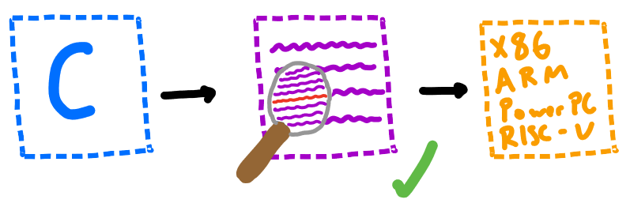
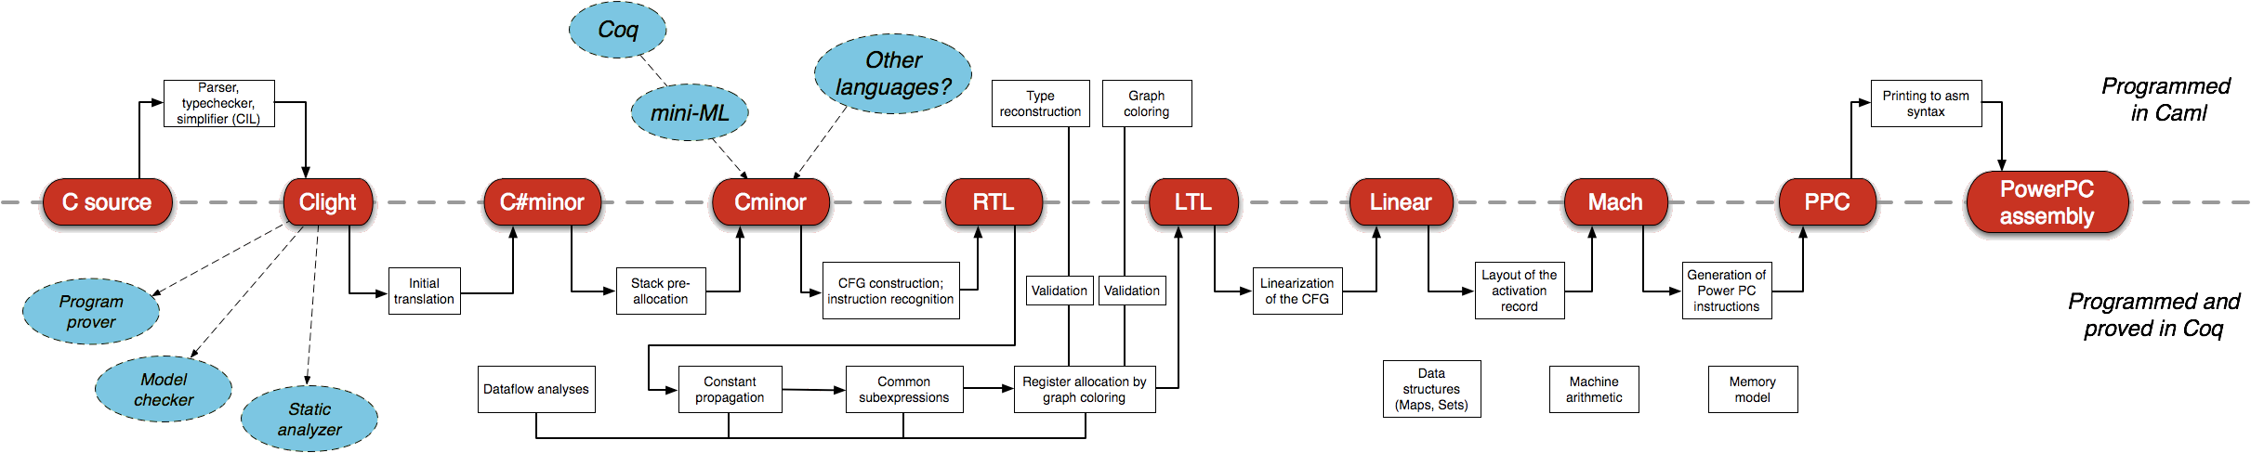
CompCert 2009
Notes:
CompCert is a verified compiler for a large subset of C
Written in Coq and OCaml, it is about 100,000 lines of code and took about 6 years to complete
Formally verifies semantic preservation of compiled programs
Suffice to say, it is very complex and quite a large project --- would be extremely hard to manually verify

Slide 25



Other Compiler Verification Projects
Notes:
There are a few other verified compilers projects that are worth mentioning
CakeML is a verified compiler for a subset of ML
CertiCoq is a verified compiler for Gallina, which is the Calclulus of Constructions implementing language that Coq uses
Finally, there have been various extensions to CompCert, such as extending it to a C subset that supports concurrency

Slide 26
Background
Compiler Correctness
Scheme

Slide 27
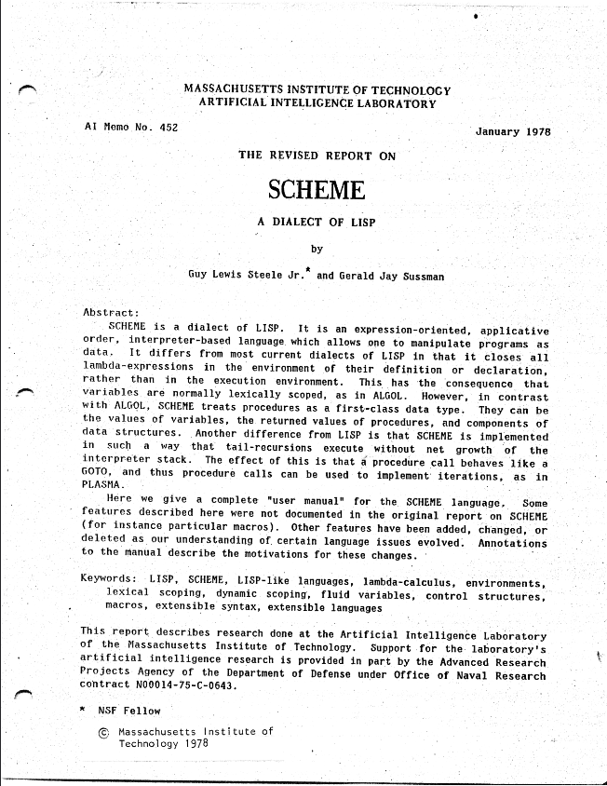

Scheme 1978
Notes:
Originally an attempt to build a LISP dialect for modeling actor-based concurrency,
While LISP supported lambda expressions, Steele and Sussman discovered they could greatly simplify LISP by following the semantics of the lambda calculus even more closely
This specifically meant using static scoping and call-by-value evaluation which more accurately follows the way the call-by-value lambda calculus works
Other important features include first class functions, homoiconity, and mutation. Though now it is also known for its macros, these were not in the original version

Slide 28
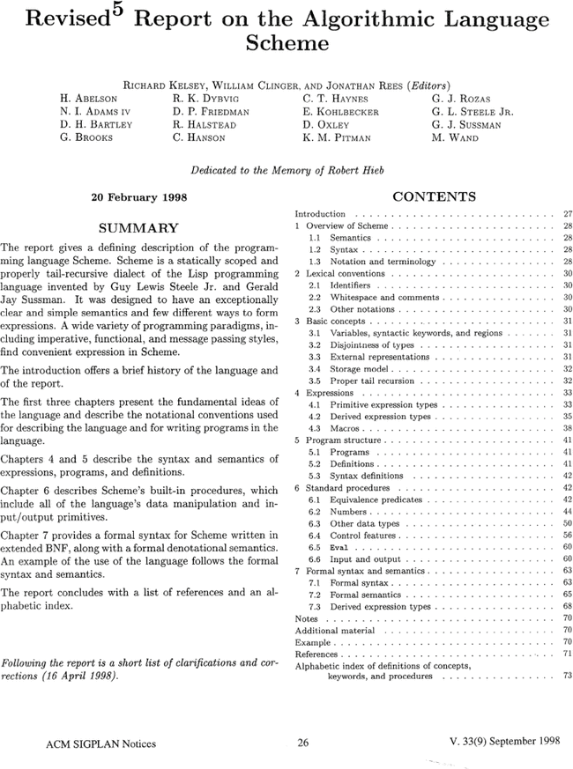
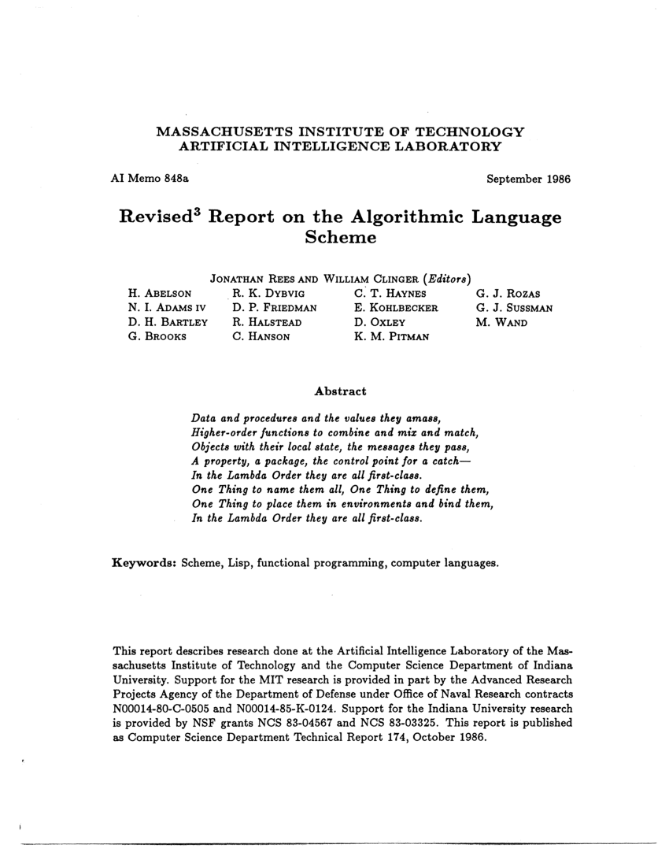
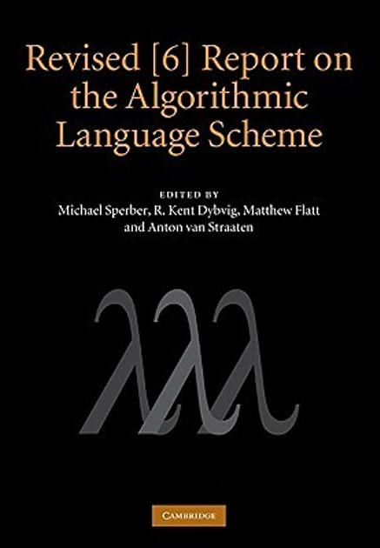
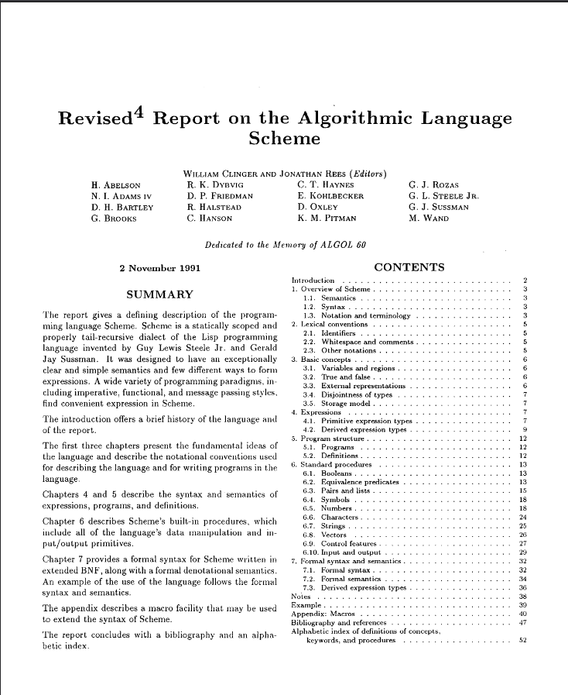
Scheme Language Standards
Notes:
Scheme has a standard in the form of the Revised n Report on the Algorithmic Language Scheme
Current version is R7RS, but we looked at R6RS because the compiler is based on that
R6RS includes a formal semantics for a subset of Scheme, as well as an implementation of the semantics, which we use for one of our validation frameworks

Slide 29
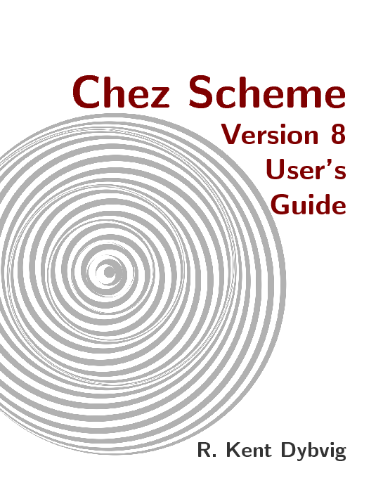

Chez Scheme
Notes:
Chez Scheme is an implementation of the R6RS standard, with an emphasis on performance
Also adds features like a C interface and concurrency
Bought by Cisco in 2011 and made open source in 2016

Slide 30
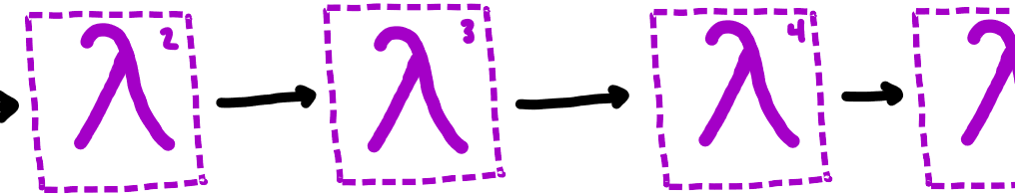
The Chez Scheme Compiler
Notes:
The compiler for Chez Scheme utilizes the Nanopass framework, also serves as the compiler for Racket
Nanopass is a DSL for easily defining intermediate languages and passes between them
Focused on very small changes from pass to pass

Slide 31
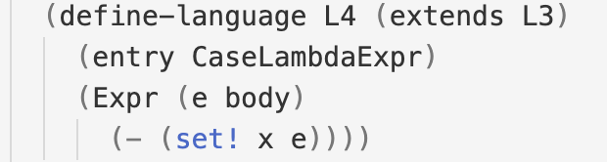
Nanopass Language Definition Example
Notes:
A quick example of a language definition
Takes the language L3 and removes set! Expressions
This is language corresponds to the pass that we are verifying

Slide 32
Outline
Introduction
Background
Definitions
Proof
Validation Frameworks
Conclusion / Future Work

Slide 33
Definitions
Syntax
Semantics
The convert-assignments pass
Notes:
Now that we have talked about the project and given some background, we will define the syntax and semantics for the subset of Scheme that we are reasoning about
Then, we will define the compiler pass over this subset

Slide 34
Syntax
Notes:
Our programs consist of a store with store locations and an expression
Store locations are either a variable and a value, or a pair pointer and a cons expression
Note that dots means zero or more, so the store can be empty too (think of Kleene star)

Slide 35
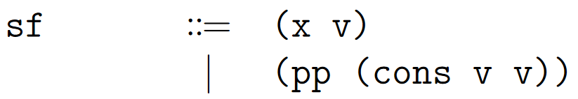
Syntax
Notes:
Our programs consist of a store with store locations and an expression
Store locations are either a variable and a value, or a pair pointer and a cons expression
Note that dots means zero or more, so the store can be empty too (think of Kleene star)

Slide 36
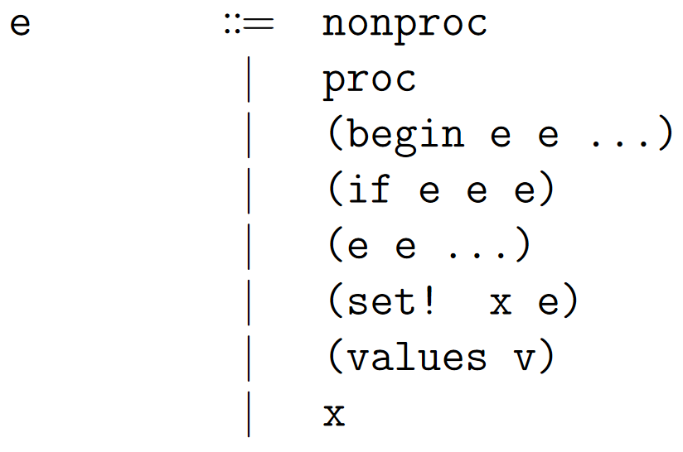
Syntax
Notes:
Expressions can be a procedure or non-procedure (more on that later)
Or a begin, if, application, set!, values expression, or a variable
We define values as all expressions that aren’t begin, if, application, etc.
Notice that values only takes one value --- more on this later

Slide 37
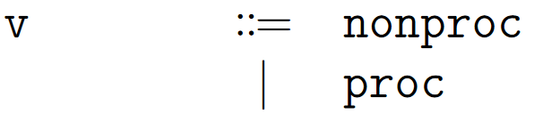
Syntax
Notes:
Expressions can be a procedure or non-procedure (more on that later)
Or a begin, if, application, set!, values expression, or a variable
We define values as all expressions that aren’t begin, if, application, etc.
Notice that values only takes one value --- more on this later

Slide 38
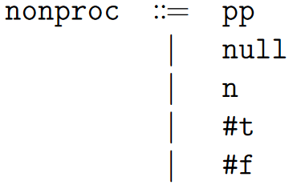
Syntax
Notes:
Nonproc is numbers, null, and pointers to store locations
Procedures are, well, procedures. Note we restrict lambda expressions to one or fewer arguments

Slide 39
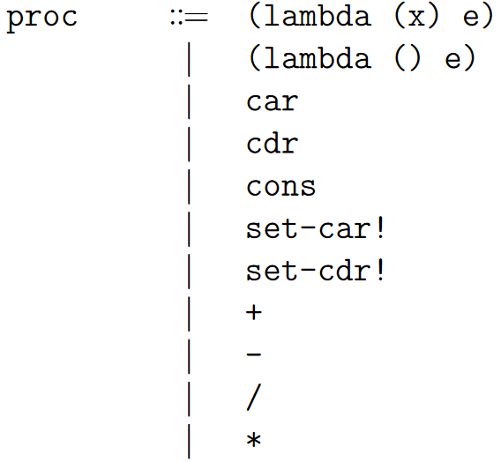
Syntax
Notes:
Nonproc is numbers, null, and pointers to store locations
Procedures are, well, procedures. Note we restrict lambda expressions to one or fewer arguments

Slide 40
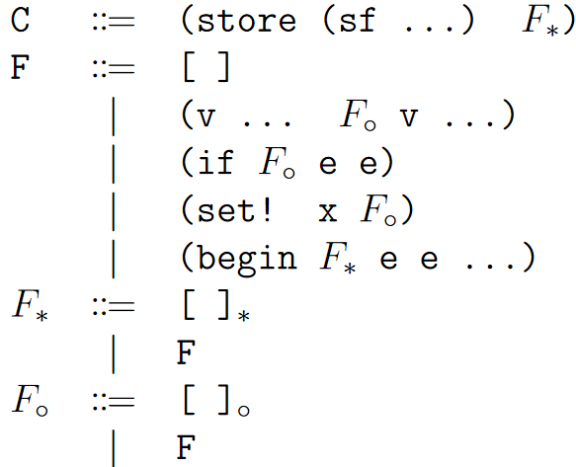
Evaluation Contexts
Notes:
Now that we’ve covered the syntax of our language, we will look at evaluation contexts.
Evaluation contexts are a set of structural congruence rules.
More concretely, they allow us to decompose programs into a context and an expression
In our specific case, they allow us to isolate specific sub-expressions in a way that enforces an evaluation order.
A quick example

Slide 41
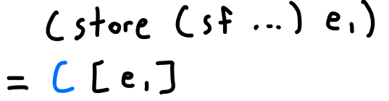
Evaluation Contexts
Notes:
For example, we can use this evaluation context to decompose this program

Slide 42
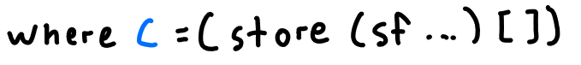
Evaluation Contexts
Notes:
For example, we can use this evaluation context to decompose this program

Slide 43
Evaluation Contexts
Notes:
First --- what is an evaluation context?
Evaluation contexts are a set of rules for structural congruence. More concretely, they allow us to decompose programs into a context and an expression
In our specific case, they allow us to isolate specific sub-expressions in a way that enforces an evaluation order.
A quick example

Slide 44
Evaluation Contexts
Notes:
First --- what is an evaluation context?
Evaluation contexts are a set of rules for structural congruence. More concretely, they allow us to decompose programs into a context and an expression
In our specific case, they allow us to isolate specific sub-expressions in a way that enforces an evaluation order.
A quick example

Slide 45
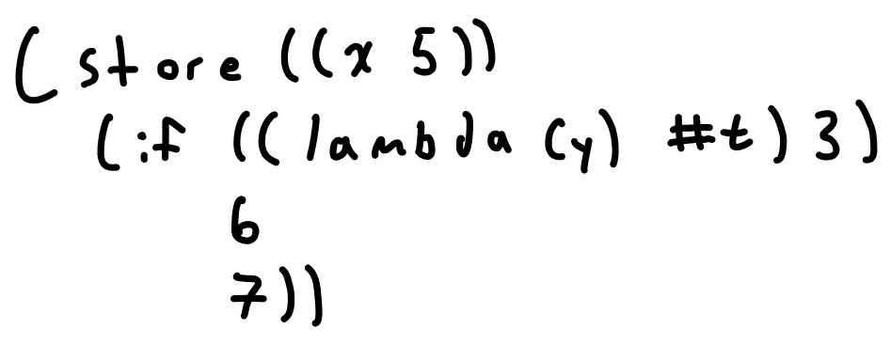
Evaluation Contexts
Notes:
Imagine we having the following program
Although we haven’t seen the semantic rules yet, we can assume there is one for application
But it would be very strange if there were a rule for application inside of an if expression… that would require a separate rule for application inside all of the different expressions…
We need a way to isolate this expression – we can use eval context decomposition

Slide 46
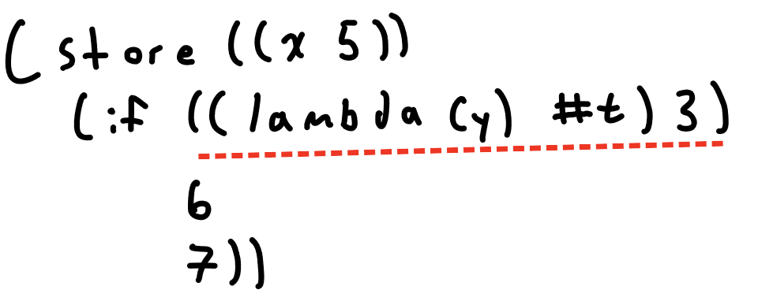
Evaluation Contexts
Notes:
Imagine we having the following program
Although we haven’t seen the semantic rules yet, we can assume there is one for application
But it would be very strange if there were a rule for application inside of an if expression… that would require a separate rule for application inside all of the different expressions…
We need a way to isolate this expression – we can use eval context decomposition

Slide 47
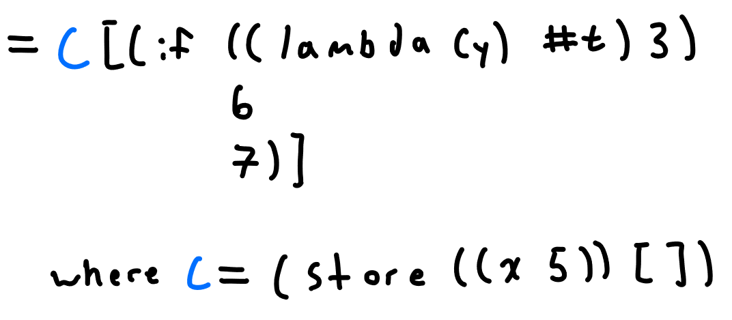
Evaluation Contexts
Notes:
First, we can decompose the program to isolate it from the store

Slide 48
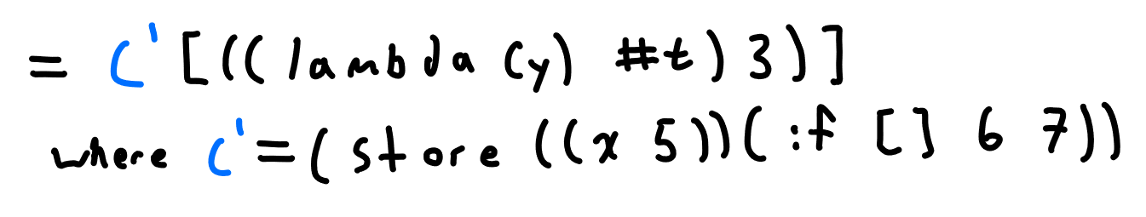
Evaluation Contexts
Notes:
Now, put the if expression into the context
By doing this decomposition, we have successfully isolated the application expression and can apply the semantic rule for application

Slide 49
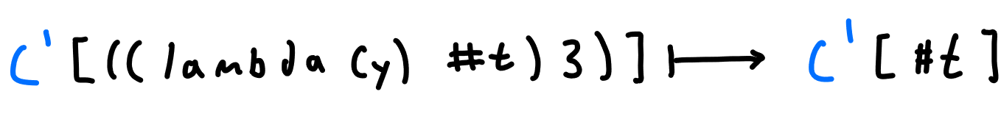
Evaluation Contexts
Notes:
Then, we can plug our reduced expression back into the eval context

Slide 50
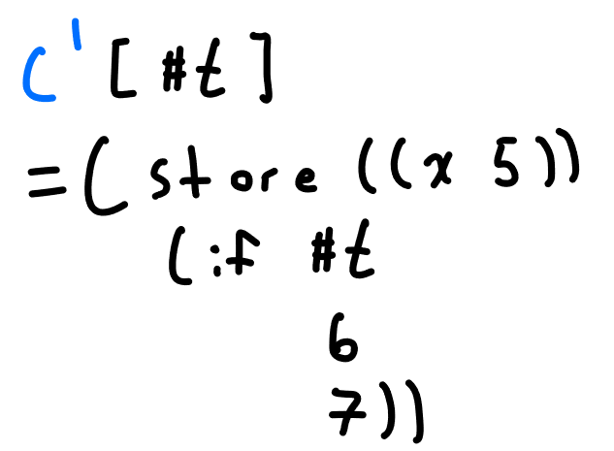
Evaluation Contexts
Notes:
Then, we can plug our reduced expression back into the eval context

Slide 51
Evaluation Contexts
Notes:
Now, looking at our eval contexts again, we see that they control where reduction can happen through the placement of their holes
But what are F star and F circle?
In the original R6RS semantics, these control where multiple values can occur – F star means the hole is expecting multiple values
We do not support multiple values, but we left these in so that our syntax would follow the R6RS semantics more closely. We will later see a similarly vestigial semantic rule.
For now, just pretend F star and F circle are just F eval contexts

Slide 52
Definitions
Syntax
Semantics
The convert-assignments pass

Slide 53
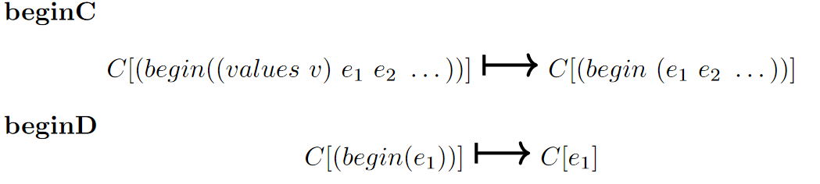
Semantics – Control Flow
Notes:
First, we can see that these rules take a program to another program, but they occur inside of an evaluation context.
The beginC rule removes values from the front of a begin expression
Combined with the begin evaluation context, we can evaluate and remove expressions from a begin statement until we get to the last one, where we apply beginD
Lets see a quick example of that happening

Slide 54
Semantics – Control Flow
Notes:
First, we can see that these rules take a program to another program, but they occur inside of an evaluation context.
The beginC rule removes values from the front of a begin expression
Combined with the begin evaluation context, we can evaluate and remove expressions from a begin statement until we get to the last one, where we apply beginD
Lets see a quick example of that happening

Slide 55
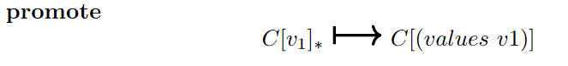
Semantics – Control Flow
Notes:
First, we can see that these rules take a program to another program, but they occur inside of an evaluation context.
The beginC rule removes values from the front of a begin expression
Combined with the begin evaluation context, we can evaluate and remove expressions from a begin statement until we get to the last one, where we apply beginD
Lets see a quick example of that happening

Slide 56
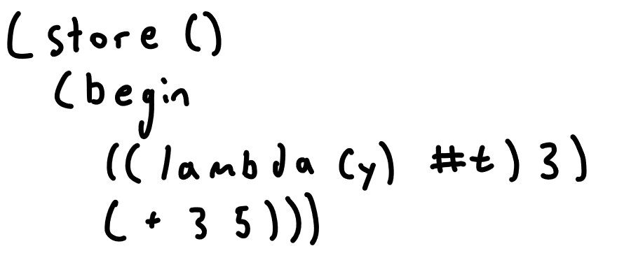
Semantics – Control Flow
Notes:
Imagine we have a program as such

Slide 57
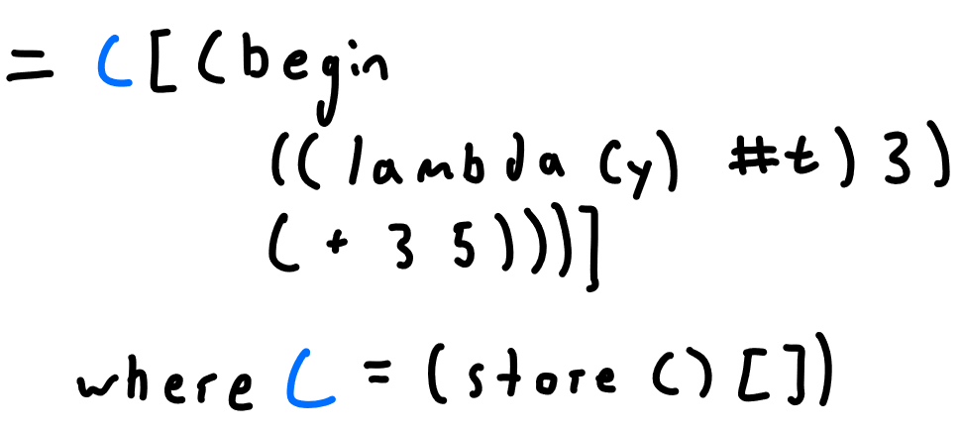
Semantics – Control Flow
Notes:
First put the store into the context

Slide 58
Semantics – Control Flow
Notes:
Then, reduce e1 with whatever applicable rules

Slide 59
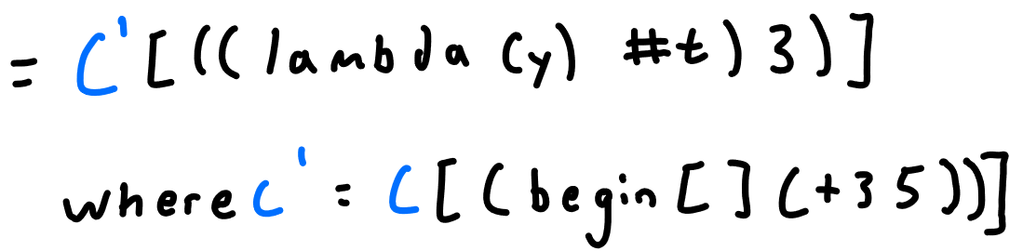
Semantics – Control Flow
Notes:
Once e1 is reduced to a value, we can apply the promote rule

Slide 60
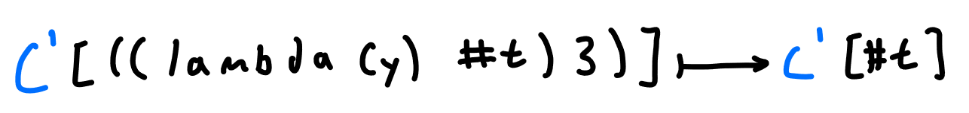
Semantics – Control Flow
Notes:
Then, plug it back into the original context

Slide 61
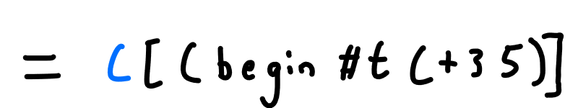
Semantics – Control Flow
Notes:
Now, we can apply the beginC rule

Slide 62
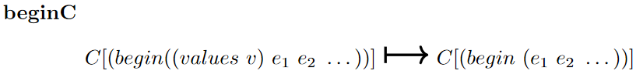
Semantics – Control Flow
Notes:
Now, we can apply the beginC rule

Slide 63
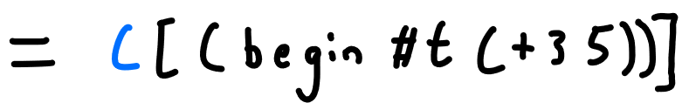
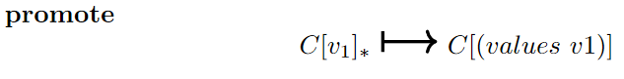
Semantics – Control Flow
Notes:
Now, we can apply the beginC rule

Slide 64
Semantics – Control Flow
Notes:
Now, we can apply the beginC rule

Slide 65

Semantics – Control Flow
Notes:
Now, we can apply the beginC rule

Slide 66

Semantics – Control Flow
Notes:
This process can now continue until we have one expression left, at which point we apply the beginD rule
This is how the R6RS semantics enforces that begin expressions result in their last expression

Slide 67


Semantics – Control Flow
Notes:
This process can now continue until we have one expression left, at which point we apply the beginD rule
This is how the R6RS semantics enforces that begin expressions result in their last expression

Slide 68

Semantics – Control Flow
Notes:
This process can now continue until we have one expression left, at which point we apply the beginD rule
This is how the R6RS semantics enforces that begin expressions result in their last expression

Slide 69

Semantics – Control Flow
Notes:
This process can now continue until we have one expression left, at which point we apply the beginD rule
This is how the R6RS semantics enforces that begin expressions result in their last expression

Slide 70

Semantics – Control Flow
Notes:
Lastly for control flow rules we have IfT and ifF which behave as expected
Notice the side condition that v1 cannot be equal to false
This also implies that any non false value is considered true, another Scheme quirk

Slide 71

Semantics – Lists
Notes:
Next we have the rule for cons
This rule takes an application of cons to two values and places it into the store with a fresh name, and replaces the expression with a reference to the location

Slide 72

Semantics – Lists
Notes:
Car and cdr work as expected, considering cons puts a pointer in its place
Car returns the first value of the pair, and cdr the second

Slide 73

Semantics – Mutation & Reference
Notes:
First we have the var rule, which works similarly to car and cdr – takes a pointer and returns the value from the store

Slide 74
Semantics – Mutation & Reference
Notes:
Next, we have set!
This works pretty much as expected as well, replacing the value of a store location. Notice that it reduces to the null value, and only operates on store locations that already exist.

Slide 75

Semantics – Mutation & Reference
Notes:
set-car! And set-cdr! Work similarly, replacing either the first and second value of a cons store location as expected, and reducing to the null value

Slide 76

Semantics – Application
Notes:
The first application related rule is mark.
Mark is the rule responsible for enforcing evaluation order
The way it works is by picking the leftmost non-value expression in an application and lifting it into its own application so it can be reduced (we will see an example in a second)

Slide 77
Semantics – Application
Notes:
The first application related rule is mark.
Mark is the rule responsible for enforcing evaluation order
The way it works is by picking the leftmost non-value expression in an application and lifting it into its own application so it can be reduced (we will see an example in a second)

Slide 78
Sidebar – Evaluation Order
Notes:
First, I want to take a second to talk about evaluation order
In the original R6RS semantics, mark is non-deterministic. That is, it picks any non-value expression from an application and lifts it.
This means that mark actually results in many different programs. The creators of the semantics did this so that evaluation order was left up to the implementation.
We slightly modify the mark rule to enforce a left-to-right evaluation order.
Chez Scheme uses a different evaluation order, something like odd elements in reverse and then even elements forwards.
It was intended to be confusing so that developers didn’t write code that relied on evaluation order

Slide 79

Semantics – Application
Notes:
Back to mark, and an example

Slide 80
Semantics – Application
Notes:
Since the cons procedure itself is a value, mark is applicable

Slide 81

Semantics – Application
Notes:
We still haven’t seen the rule for application, but remember that Scheme is based on the call by value lambda calculus
Therefore, we cannot directly substitute e1 since it is not a value

Slide 82
Semantics – Application
Notes:
Since lambda expressions are values, we can decompose the program using the application evaluation context
Remember that dots are like a Kleene star, so the fact that there are no values after e1 is ok

Slide 83

Semantics – Application
Notes:
Since lambda expressions are values, we can decompose the program using the application evaluation context
Remember that dots are like a Kleene star, so the fact that there are no values after e1 is ok

Slide 84



Semantics – Application
Notes:
Now, e1 is alone so it can reduce to some value

Slide 85

Semantics – Application
Notes:
And we can plug it back into the context

Slide 86
Semantics – Application
Notes:
Now that we have a value to apply to the lambda, we can use the appN rule (that we haven’t seen yet) to perform substituition

Slide 87

Semantics – Application
Notes:
Now, mark can apply again, since cons and v1 are both values
This example shows how expressions are evaluated to values in a left to right order

Slide 88
Semantics – Application
Notes:
Now, mark can apply again, since cons and v1 are both values
This example shows how expressions are evaluated to values in a left to right order

Slide 89
Semantics – Application
Notes:
Now, mark can apply again, since cons and v1 are both values
This example shows how expressions are evaluated to values in a left to right order

Slide 90

Semantics – Application
Notes:
Now, for the actual application rules
appN! applies when the argument of the lambda expression is the target of a set! In its body
In that case, appN! Needs to create a fresh store location so that mutation can occur. If we just did naïve substitution here, we could end up with expressions like set! 3 4
appN is the rule that just does direct substitution as we would expect
Also notice that these rules leave behind lambdas with empty arguments, which we eliminate with the app0 rule

Slide 91

Semantics – Application
Notes:
Now, for the actual application rules
appN! applies when the argument of the lambda expression is the target of a set! In its body
In that case, appN! Needs to create a fresh store location so that mutation can occur. If we just did naïve substitution here, we could end up with expressions like set! 3 4
appN is the rule that just does direct substitution as we would expect
Also notice that these rules leave behind lambdas with empty arguments, which we eliminate with the app0 rule

Slide 92

Semantics – Application
Notes:
Now, for the actual application rules
appN! applies when the argument of the lambda expression is the target of a set! In its body
In that case, appN! Needs to create a fresh store location so that mutation can occur. If we just did naïve substitution here, we could end up with expressions like set! 3 4
appN is the rule that just does direct substitution as we would expect
Also notice that these rules leave behind lambdas with empty arguments, which we eliminate with the app0 rule

Slide 93

Semantics – Application
Notes:
Now, for the actual application rules
appN! applies when the argument of the lambda expression is the target of a set! In its body
In that case, appN! Needs to create a fresh store location so that mutation can occur. If we just did naïve substitution here, we could end up with expressions like set! 3 4
appN is the rule that just does direct substitution as we would expect
Also notice that these rules leave behind lambdas with empty arguments, which we eliminate with the app0 rule

Slide 94
Semantics – Application
Notes:
Now, for the actual application rules
appN! applies when the argument of the lambda expression is the target of a set! In its body
In that case, appN! Needs to create a fresh store location so that mutation can occur. If we just did naïve substitution here, we could end up with expressions like set! 3 4
appN is the rule that just does direct substitution as we would expect
Also notice that these rules leave behind lambdas with empty arguments, which we eliminate with the app0 rule

Slide 95

Semantics – Application
Notes:
Now, for the actual application rules
appN! applies when the argument of the lambda expression is the target of a set! In its body
In that case, appN! Needs to create a fresh store location so that mutation can occur. If we just did naïve substitution here, we could end up with expressions like set! 3 4
appN is the rule that just does direct substitution as we would expect
Also notice that these rules leave behind lambdas with empty arguments, which we eliminate with the app0 rule

Slide 96

Semantics – Application
Notes:
Now, for the actual application rules
appN! applies when the argument of the lambda expression is the target of a set! In its body
In that case, appN! Needs to create a fresh store location so that mutation can occur. If we just did naïve substitution here, we could end up with expressions like set! 3 4
appN is the rule that just does direct substitution as we would expect
Also notice that these rules leave behind lambdas with empty arguments, which we eliminate with the app0 rule

Slide 97

Semantics – Application
Notes:
Now, for the actual application rules
appN! applies when the argument of the lambda expression is the target of a set! In its body
In that case, appN! Needs to create a fresh store location so that mutation can occur. If we just did naïve substitution here, we could end up with expressions like set! 3 4
appN is the rule that just does direct substitution as we would expect
Also notice that these rules leave behind lambdas with empty arguments, which we eliminate with the app0 rule

Slide 98

Semantics – Application
Notes:
Now, for the actual application rules
appN! applies when the argument of the lambda expression is the target of a set! In its body
In that case, appN! Needs to create a fresh store location so that mutation can occur. If we just did naïve substitution here, we could end up with expressions like set! 3 4
appN is the rule that just does direct substitution as we would expect
Also notice that these rules leave behind lambdas with empty arguments, which we eliminate with the app0 rule

Slide 99

Semantics – Values
Notes:
These are the rules for dealing with value expressions
We already saw promote, demote does the opposite
Since we do not actually support multiple values, these are pretty much vestigial rules, they just wrap and unwrap as appropriate to apply beginC or other rules

Slide 100

Semantics – Arithmetic
Notes:
Finally, we have our rules for arithmetic
These rules pretty much all work as expected, and aren’t super important to our proof.
We just include them to have a more complete language that you can actually do things in

Slide 101

Semantics – Arithmetic
Notes:
Finally, we have our rules for arithmetic
These rules pretty much all work as expected, and aren’t super important to our proof.
We just include them to have a more complete language that you can actually do things in

Slide 102
Definitions
Syntax
Semantics
The convert-assignments pass
Notes:
That wraps up our semantic rules
Now we will take a look at the compiler pass that we will be reasoning about, convert-assignments

Slide 103
convert-assignments
Notes:
As we hinted at before, convert-assignments removes set! expressions from the language
More specifically, its purpose is to remove indefinite extent assignments and replace them with assignments that have a defined scope

Slide 104

convert-assignments Erasing
Notes:
One problem with trying to reason about convert-assignments is that it operates on Chez Scheme expressions that aren’t explicitly in the R6RS semantics
To counter this problem with respect to the source and target languages, we assume that expressions behave as their erased equivalent does
We can see an example of this above, with a Chez Scheme expression and its erased version in the semantics language
Another way we erase, or more desugar, is by converting let expressions into applications

Slide 105

convert-assignments Modeling
Notes:
The second issue stems from the fact that convert-assignments is written in Chez Scheme
Basically, we cannot reason directly about the source code of the pass because it has many forms which our semantics does not cover
To solve this problem, we model the behavior of the pass in our proof by carefully observing the pass’s code and testing many examples to learn its behavior

Slide 106

convert-assignments Intuition
Notes:
Before we define our model of convert-assignments, its best to look at an example to gain an intuition of how it behaves
We will focus in on each individual part of this example shortly, but the basic intuition is that convert-assignments changes all set! expressions to set-car! expressions, and changes other expressions accordingly

Slide 107
convert-assignments Intuition
Notes:
The first part of the transformation we look at is on store locations.
Since appN! is the only rule that can create new non-list store locations, we can assume that any variable in the store was once the target of a set!
Therefore, we transform them all to list store locations, since set! expressions are now set-car! expressions
Also notice that v1 is transformed, which we write as v1 hat

Slide 108
convert-assignments Intuition
Notes:
The next part is the transformations effect on set!
We see that set! is transformed to set-car!, and that v2 is also recursively transformed.
Because there is a set! expression that targets its argument, lambda (y) is transformed, which will we see the full effect of shortly.
However, even now we can see it is being wrapped in another lambda expression

Slide 109
convert-assignments Intuition
Notes:
Now we can see the effect on variables, both from the store and ones that are bound as an argument
Both kinds of variables are wrapped in a car application, since they now implicitly refer to lists
Notice that the variable from the store is transformed to a pair pointer, to match the transformation of the store location
However, we do not transform the locally bound variable, since it has yet to be substituted into

Slide 110
convert-assignments Intuition
Notes:
Finally, we are able to see why we introduce the additional lambda
Since our original lambda now operates on its arguments as a list, we have to ensure that these procedures are actually given lists
Therefore, we wrap any argument it would receive into a fresh, single element list

Slide 111

convert-assignments Definition
Notes:
With an intuition for the transformation acquired, we now formally define our model of the pass
To save a bit of space with notation, we assume that these functions have access to the store and to a list of names that are the target of a set! in the program
The first definition is ca prog, which just calls the appropriate functions on the elements of the program

Slide 112

convert-assignments Definition
Notes:
As we previously observed, ca on store locations transforms non list store locations into list store locations
Store locations that already refer to a list are unchanged except for transforming their values

Slide 113

convert-assignments Definition
Notes:
Convert assignments on expressions leaves most expressions unchanged except for recursive calls on sub-expressions
However, it does transform set!, lambda, and variable expressions as previously covered

Slide 114

convert-assignments Definition
Notes:
Convert assignments on expressions leaves most expressions unchanged except for recursive calls on sub-expressions
However, it does transform set!, lambda, and variable expressions as previously covered

Slide 115

convert-assignments Definition
Notes:
Convert assignments on expressions leaves most expressions unchanged except for recursive calls on sub-expressions
However, it does transform set!, lambda, and variable expressions as previously covered

Slide 116

convert-assignments Definition
Notes:
Convert assignments on expressions leaves most expressions unchanged except for recursive calls on sub-expressions
However, it does transform set!, lambda, and variable expressions as previously covered

Slide 117

convert-assignments Definition
Notes:
We also define convert-assignments for evaluation contexts to be able to use it on decomposed programs.
Since our semantic steps operate on decomposed programs, this part of the transformation is key to our proof
The transformations occur as expected for the equivalent expressions

Slide 118



convert-assignments Lemmas
Notes:
In our paper, we prove these lemmas, but their proofs are not very interesting, so we will just state them here

Slide 119
Proof
Overview
Deterministic Semantics
ca is a simulation relation
Notes:
With our language and the transformation defined, we will now begin our proof of correctness of the pass

Slide 120

Proof Overview
Notes:
We want to show that ca prog preserves the semantics of programs that it transforms i.e. the programs should take similar semantic steps
Since ca prog removes set! Expressions from programs, we can’t expect the two programs to take the same exact steps
We do expect them to take equivalent steps, though
Since ca prog introduces some additional expressions, we should expect the transformed version to take multiple steps to the originals one step

Slide 121

Multiple Steps
Notes:
Since we expect the transformed program to take multiple steps to the originals one, we need to formally define a way for programs to take many steps
Specifically, the transitive, reflexive closure lets a program take zero or more steps

Slide 122

Equivalent Steps - Simulation
Notes:
So, overall we are trying to show that if P takes a step and then transforms, it is the same as if it transforms and then takes zero or more steps
This is the same as saying that ca prog is a simulation relation
If we can prove this, we can easily no matter how many steps P takes, that its transformed version will always take equivalent steps
Moreover, if P gets to a value, then ca prog of P will get to the transformed version of that value

Slide 123
Proof
Overview
VSR Property
ca is a simulation relation
Notes:
Now that we know what we are trying to prove, we first want to show a property of all programs in our language
Namely, we want to show the VSR property, which says that our programs are either values, stuck, or reducible

Slide 124

VSR Property Definition

Slide 125

VSR Property Proof

Slide 126

VSR Property Proof

Slide 127

VSR Property Proof

Slide 128

VSR Property Proof
Notes:
By our induction principle, we know that our subexpressions are all either values, stuck, or reducible if placed in the expression slot of a program

Slide 129

VSR Property Proof
Notes:
If there are no e2s, clearly reducible by beginD, with the unique context being just the store

Slide 130

VSR Property Proof

Slide 131
VSR Property Proof

Slide 132

VSR Property Proof
Notes:
In which case we can apply promote, and the unique context is the store, with a star hole as required by promote

Slide 133

VSR Property Proof
Notes:
If e1 is stuck, then we are stuck, since our evaluation context can only isolate the first subexpression
UNLESS

Slide 134
VSR Property Proof
Notes:
e1 is a values expression. Values expressions are stuck by our definition, but

Slide 135

VSR Property Proof
Notes:
We can apply the beginC rule in this case

Slide 136

VSR Property Proof
Notes:
With the unique context being begin

Slide 137

VSR Property Proof

Slide 138

VSR Property Proof

Slide 139

VSR Property Proof

Slide 140

VSR Property Proof

Slide 141

VSR Property Proof

Slide 142

VSR Property Proof

Slide 143

VSR Property Proof

Slide 144

VSR Property Proof
Notes:
There are many possibly applicable rules here
If our subexpressions are of the form of one of these rules, then our program is reducible by that rule
Otherwise, we are stuck, since the application evaluation context does not allow us to use the promote rule on any of these values

Slide 145

VSR Property Proof

Slide 146

VSR Property Proof

Slide 147

VSR Property Proof

Slide 148

VSR Property Proof
Notes:
Next consider if subexpressions are a mix of values, stuck, and reducible expressions

Slide 149
VSR Property Proof
Notes:
In this case, the only possible moves are either applying the mark rule or decomposing using the application evaluation context

Slide 150
VSR Property Proof
Notes:
Again, because of the side condition of mark, these two things can never happen at the same time
Since these are the only two possible moves on application expressions with mixed value and non-value subexpressions, either one of these rules is applicable or we are stuck
If mark is applicable, obviously P is reducible. Otherwise, if the application evaluation context is applicable, then P is either reducible or stuck depending on the subexpression that we isolate

Slide 151

VSR Property Proof

Slide 152

VSR Property Proof

Slide 153

VSR Property Proof

Slide 154

VSR Property Proof
Notes:
As we said before, values expressions at the program level are stuck

Slide 155

VSR Property Proof

Slide 156

VSR Property Proof
Notes:
If x is not the store, we are stuck, otherwise we can apply the var rule
Therefore, since we have considered all possibilities of e, we have shown this property of all programs

Slide 157
Proof
Overview
VSR Property
ca is a simulation relation

Slide 158
Simulation Proof

Slide 159

Simulation Proof

Slide 160


Simulation Proof

Slide 161

Simulation Proof
Notes:
If the program is a value, it steps to a values expression by the promote rule
Since we know that v hat is also a value, promote is also applicable and we are done

Slide 162

Simulation Proof

Slide 163

Simulation Proof
Notes:
Now we consider the case where P is reducible
Since P is reducible, it must be of the form of the left hand side of one of our semantic steps
We will first consider if appN! Is applicable

Slide 164

Simulation Proof
Notes:
If so, P must be of the following form

Slide 165

Simulation Proof
Notes:
We apply the appN! Rule to get P’

Slide 166

Simulation Proof
Notes:
Next, we transform P to get P hat. Since appN! Is applicable, we know that x is assigned to inside of e, therefore we do the transformation

Slide 167

Simulation Proof
Notes:
Simlarly, we transform p prime to get p prime hat

Slide 168

Simulation Proof
Notes:
So, we are trying to show that P hat takes zero or more steps to P prime hat
We will show that it takes 5 steps

Slide 169

Simulation Proof

Slide 170

Simulation Proof

Slide 171

Simulation Proof

Slide 172

Simulation Proof
Notes:
Now we have a lambda and a non-value expression in an application, so we have to decompose using the application eval context

Slide 173

Simulation Proof

Slide 174

Simulation Proof

Slide 175

Simulation Proof
Notes:
Then we can plug the pointer back into our original context

Slide 176

Simulation Proof

Slide 177
Simulation Proof
Notes:
As we can see, it takes 5 steps to get to p prime hat

Slide 178

Simulation Proof
Notes:
We summarize this with the following diagram

Slide 179

Simulation Proof
Notes:
For the var and set! rules, there are two possible cases
If the variable or the target of the set! Was in the store, we directly replace the variable with a pointer, so there is just one equivalent rule

Slide 180

Simulation Proof
Notes:
If the variable was in a lambda, by the time the var or set! Rules are applied, the variable will have been substituted for a cons expression
So we first apply cons, and then the equivalent rule

Slide 181

Simulation Proof
Notes:
For all other steps, ca prog does not make a change, and the same semantic step is taken

Slide 182
Simulation Proof
Notes:
Therefore, we have shown that ca prog is a simulation relation and semantic preserving

Slide 183
Validation Frameworks
Overview
Coq
Racket

Slide 184


Validation Frameworks
Notes:
Now that we have given our paper proof, we are in the same position that we mentioned in the intro
Even though our proof is not exceptionally long, manually checking it still requires time and knowledge of the R6RS semantics

Slide 185

Validation Frameworks
Notes:
The original intent of this project was to fully mechanize this proof in Coq, but we ran out of time to do so

Slide 186

Validation Frameworks
Notes:
Part of the reason for that was my own inexperience with the language and with proof assistants in general, but another reason is the high level of detail required for mechanization
The nature of these proof assistants with foundations in intuitionistic logic means that every minute detail must be included to be able to prove theorems

Slide 187

Validation Frameworks
Notes:
Just as an example, we prove this property in our framework, that if a variable is fresh in a term, that substitution of that variable is the same as the identity function
In our paper proof, we don’t prove this or feel the need to, and I would be surprised if many paper proofs include this sort of proof at all
This is just a single example, but it can give you an idea of the increase in scale from a paper proof to a mechanized proof
Suffice to say, an intimate knowledge of the problem domain is required for any mechanized proof, no handwaving allowed

Slide 188
Validation Frameworks
Notes:
Since our mechanization was not completed, we wanted to have another means of validating our proof
Luckily, there is an existing implementation of the R6RS semantics
Therefore, by modeling the convert-assignment functions in Racket, we were able to test that our step lemma holds for a variety of programs
While this is far from definitive evidence of the correctness of our proof, empirical evidence of validity is always good

Slide 189
Validation Frameworks
Intro
Coq
Racket
Notes:
Now we will go over each of our frameworks in more detail

Slide 190
Coq Framework
Notes:
While we were not able to provide a complete mechanization of our proof, we do provide an implementation of a subset of the R6RS semantics
We also model the pass itself
However, there are some specific details about our implementation that are worth talking about

Slide 191


Capture-free Substitution
Notes:
The R6RS semantics specifies that its rules for application perform capture-free substituition
However, the means of achieving this is left up to the implementation
Inspired by Aydemir et al. on the left, we decided to use the locally nameless style for variable bindings, which provides capture free substitution and makes for easier reasoning about names

Slide 192

Locally Nameless Bindings
Notes:
In the locally nameless style, bound variables are represented by de Bruijn indices, and free variables by names
The index corresponds to the level of abstraction. Therefore, lambda expressions do not need to specify a formal argument

Slide 193

Locally Nameless Bindings

Slide 194
Opening and Closing

Slide 195
Locally Closed (Well Formed)

Slide 196
Validation Frameworks
Intro
Coq
Racket
Notes:
Now we will go over each of our frameworks in more detail

Slide 197
Racket Framework

Slide 198
Outline
Introduction
Background
Formalizing Scheme
Proof
Validation Frameworks
Conclusion / Future Work

Slide 199
Future Work
Notes:
Finishing the mechanization

Slide 200
Future Work
Notes:
Extending Racket framework

Slide 201
Future Work
Notes:
Proving ca over a bigger set of Scheme

Slide 202
Future Work
Notes:
Evaluation order / non-determinism

Slide 203
Future Work
Notes:
Proving other passes

Slide 204
Bibliography
K. Sandler, L. Ohrstrom, L. Moy, and R. McVay, “Killed by code: Software transparency in implantable medical devices,” Software Freedom Law Center, pp. 308–319, 2010.
I. Lee et al., “High-confidence medical device software and systems,” Computer, vol. 39, no. 4, pp. 33–38, 2006, doi: 10.1109/MC.2006.127.
J. Mccarthy and J. Painter, “Correctness of a compiler for arithmetic expressions,” 1967, pp. 33–41.
N. G. de Bruijn, “A Survey of the Project Automath**Reprinted from: Seldin, J. P. and Hindley, J. R., eds., To H. B. Curry: Essays on Combinatory Logic, Lambda Calculus and Formalism, p. 579-606, by courtesy of Academic Press Inc., Orlando.,” in Selected Papers on Automath, vol. 133, R. P. Nederpelt, J. H. Geuvers, and R. C. de Vrijer, Eds. Elsevier, 1994, pp. 141–161. doi: 10.1016/S0049-237X(08)70203-9.
J.-Y. Girard, “Interprétation fonctionnelle et élimination des coupures de l’arithmétique d’ordre supérieur,” PhD Thesis, Éditeur inconnu, 1972.
P. Martin-Löf, “An intuitionistic theory of types,” Twenty-five years of constructive type theory, vol. 36, pp. 127–172, 1998.
T. Coquand and G. Huet, “The calculus of constructions,” PhD Thesis, INRIA, 1986.
X. Leroy, “Formal Verification of a Realistic Compiler,” Commun. ACM, vol. 52, no. 7, pp. 107–115, Jul. 2009, doi: 10.1145/1538788.1538814.
G. L. Steele Jr and G. J. Sussman, “The Revised Report on SCHEME: A Dialect of LISP.,” MASSACHUSETTS INST OF TECH CAMBRIDGE ARTIFICIAL IN℡LIGENCE LAB, 1978.

